Slide 1
Bioassessment in Vermont’s Forested Wetlands: Past, Present, and Future

Slide 2
Vermont Wetlands Program
A part of the Vermont Department of Environmental Conservation, Watershed Management Division
Much of program is devoted to regulatory work under the Vermont Wetland Rules
1 full time staff member devoted to monitoring, with support from other staff
Notes:
TH: Use white font? The slides are dark.
Switch “Permitting” to “regulatory work under the Vermont Wetland Rules”

Slide 3
Wetlands Bioassessment Purposes
To monitor the health of Vermont’s wetlands
To provide support for planning and regulatory activity
To monitor the effectiveness of restoration and rehabilitation projects
To monitor long-term trends of wetland health
Notes:
TH: Here are the 4 main goals we’ve presented in the past:
To monitor the health of Vermont’s wetlands
To provide support for planning and regulatory activity
To monitor the effectiveness of restoration and rehabilitation projects
To monitor long-term trends of wetland health

Slide 4
Wetlands Bioassessment Methods
Conduct Tier III intensive surveys to collect biological, chemical, and physical data
Use the FQAI as a biological indicator of wetland health
Utilize the Vermont Rapid Assesssment Method (VRAM), a Tier II method …”
Refine mapping of wetlands when necessary
Classify wetlands via Heritage natural community methodology or a similar but somewhat coarser classification system
Notes:
TH: I would reword the first three bullet points:
Conduct Tier III intensive surveys to collect biological, chemical, and physical data
Use the FQAI as a biological indicator of wetland health
Utilize the Vermont Rapid Assesssment Method (VRAM), a Tier II method …”

Slide 5
Bioassessment and Forested Wetlands
Some past Wetlands site selection methodology (random stratified site selection) heavily favored emergent wetlands and shrub swamps
Older National Wetlands Inventory maps missed a lot of forested wetlands, causing them to be missed.
Natural Heritage Inventory has extensive plot data on forested wetlands
Forested buffer and upland watershed also important to wetlands
Notes:
TH: I would site some cool forested natural communities that we have conducted Tier III assessments on.

Slide 6
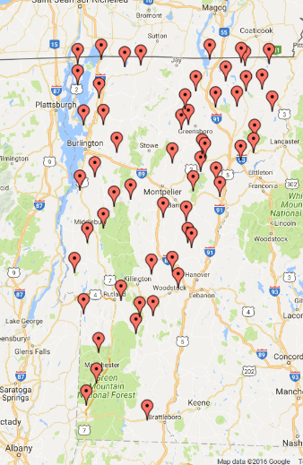
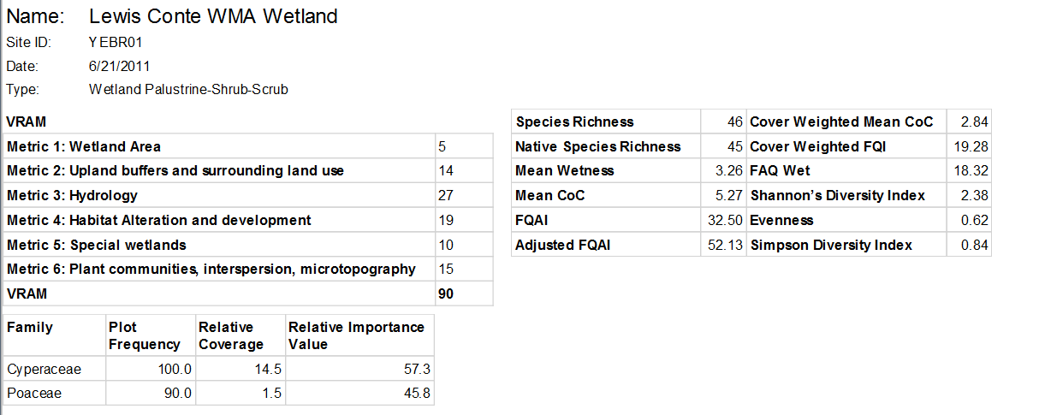
Existing Bioassessment Data, 2006-2014
(not limited to forested wetlands)

Slide 7
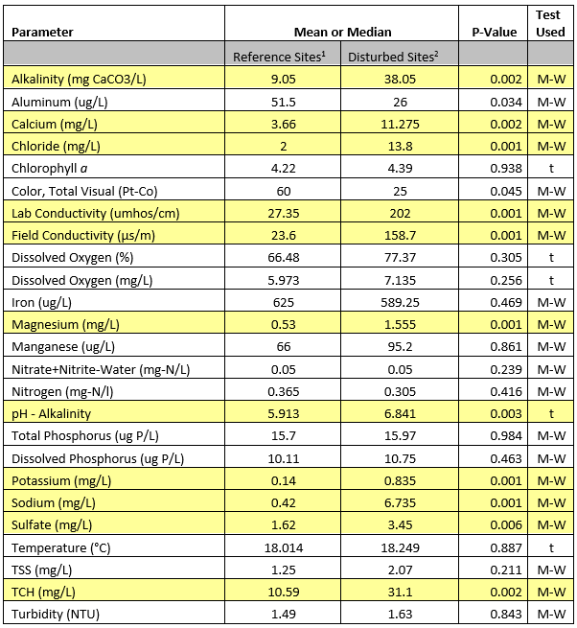
Wetland Condition Correlates with Water Quality
T-test (t) and Mann-Whitney rank sum test (M-W) results for water chemistry parameters comparing minimally disturbed and highly disturbed sites. Means are presented for the t-tests and medians for the Mann-Whitney rank sum tests. Yellow indicates parameters with a statistically significant P value of ≤0.009.

Slide 8
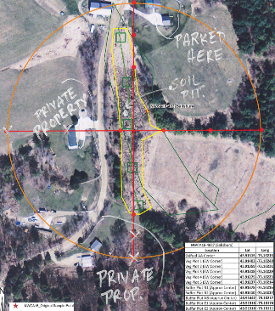
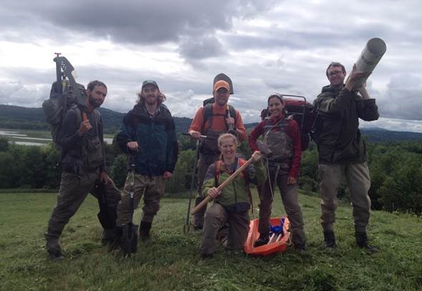
2016 Bioassessment: 9 NWCA Sites
Notes:
TH: I would quickly mention that we have participated in the 2011 NWCA too

Slide 9
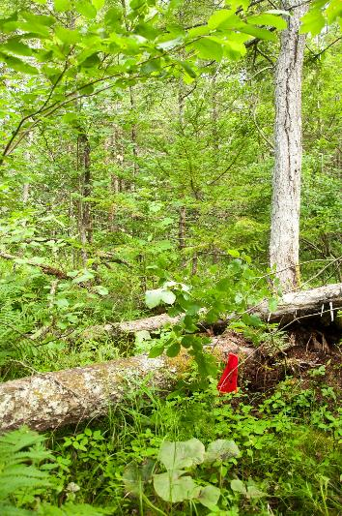
Sample Forested Wetlands: Seepage Swamp in Ripton

Slide 10
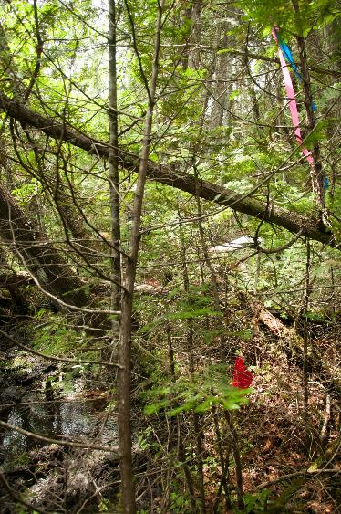
Sampled Forested Wetlands: Cedar Swamp in Peacham

Slide 11
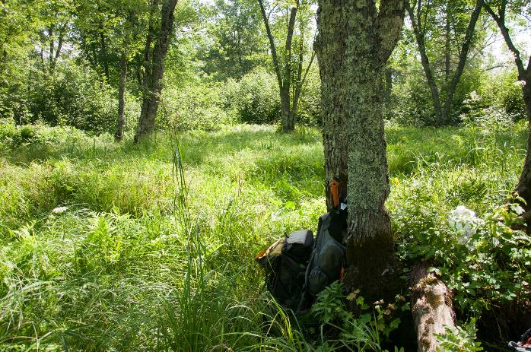
Sampled Forested Wetlands: Floodplain Forest in Charleston

Slide 12
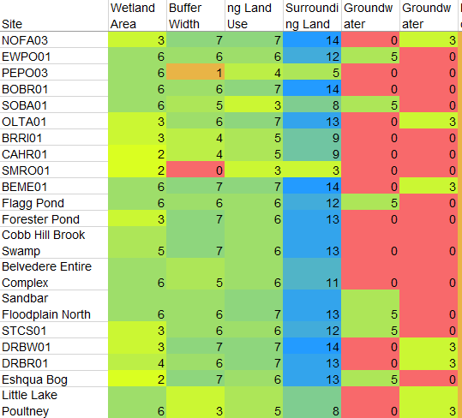
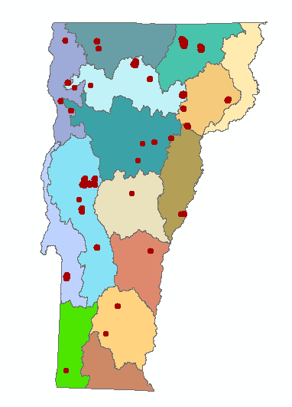
2016 Bioassessment: Vermont Rapid Assessment Method (Citizen science protocol currently in development)
Notes:
Brief (Re-) intro to VRAM, where it comes from, what it does, what we plan to do with it (citizen science/wide audience).
We have tested VRAM with an older ‘Human Disturbance Ratio’ ranking to calibrate, and have conducted around 100 VRAM assessments.
We have used them for Class 1 work.

Slide 13
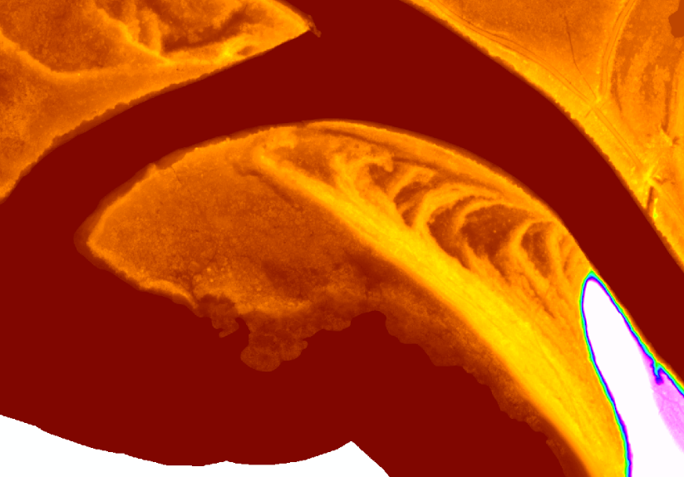
2016: Mapping and LIDAR

Slide 14
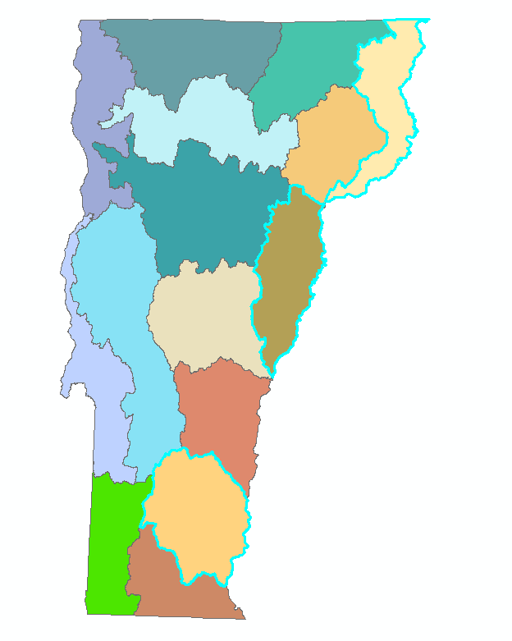
Future of Wetlands Bioassessment
Link biological condition with Wetland Rules and Water Quality Standards
Site selection based on a rotational basin schedule and collaboration with other monitoring programs
Build biocriteria- that can provide a measure of wetland health and integrity
Classification of wetland types
Notes:
TH:
Continue monitoring- to link biological condition with Wetland Rules and Water Quality Standards
Site planning and selection based on a 5 year-rotational basin schedule and collaboration with other monitoring programs
Build biocriteria- create a system that can provide a measure of wetland health and overall biological integrity
Classification of wetland types
CH: I shrank these down a little, really text heavy otherwise, but don’t feel strongly

Slide 15
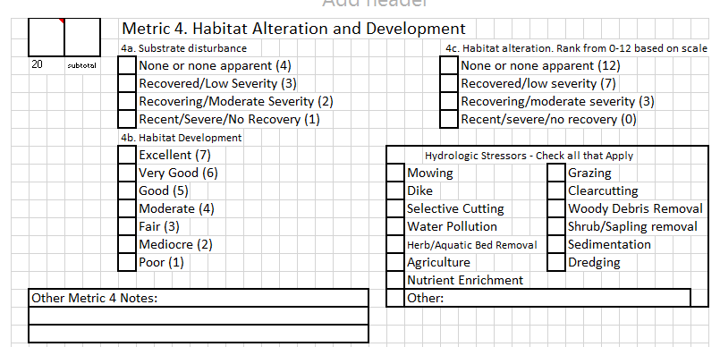
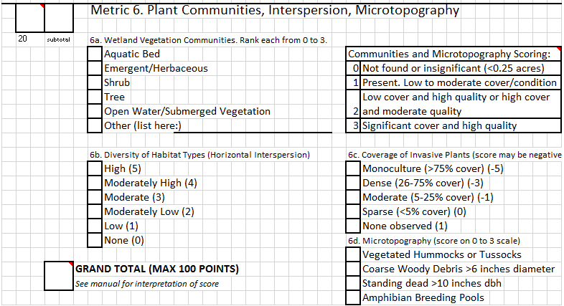
Future of Wetlands Bioassessment: VRAM
Updates to protocol
Citizen Science/stakeholder manual
Web portal
Display characteristics of wetland based on data added.

Slide 16
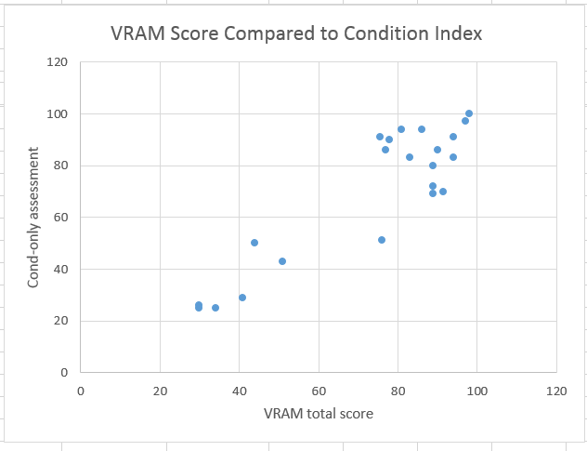
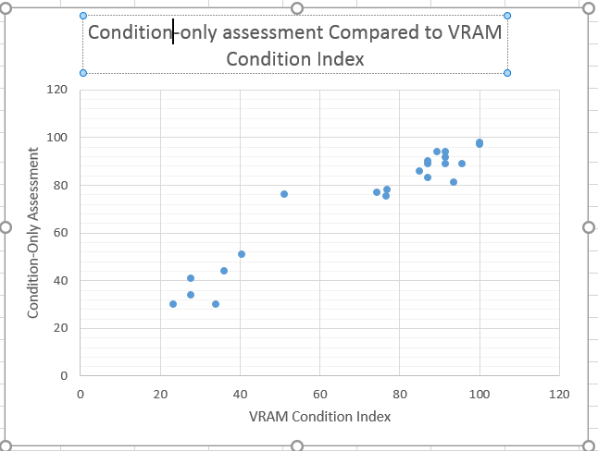
Using VRAM to Assess Condition

Slide 17
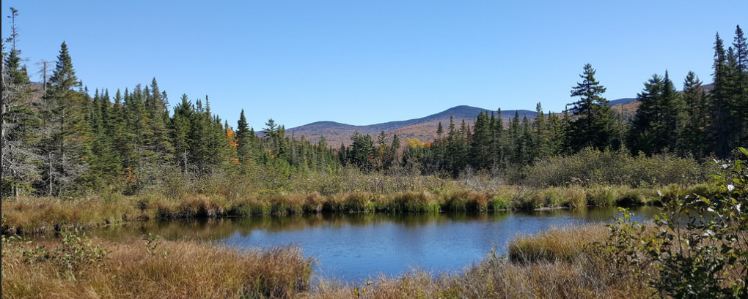
Potential for Collaboration
Come to working session today to discuss updates to VRAM
Reach out to us about using VRAM in your own group
We are interested in any and all wetland data you can share!

